Slide 1
Relaxation and Happiness
Srikant Annavarapu, PhD
Core Team Member, Rekhi Center of Excellence for the Science of Happiness
Associate Professor, Department of Mining Engineering

Slide 2
Outline
Safety Share
What is important?
Focus and Concentration
Heartfulness
Practical Demonstration
Relaxation and Happiness

Slide 3
Safety Share
Everyone going home safe everyday
Zero Harm
Relaxation and Happiness

Slide 4
What's important in your life?
God
Love
Family
Music
Health
Friends
Happiness
Food and Drink
Parents
Life
Knowledge
Environment
Money
Science
Home
Being a good person
Intelligence
Confidence
Relaxation and Happiness

Slide 5
Towards balance
Implement
  Just do it!
Plan
  Plan for these priorities – don’t leave it to ‘someday’
  Identify your inefficiencies
Prioritize
  Everything cannot be important and urgent – identify what is
  Allocate a time frame
Clarity of goal
  Write down what’s important for you- make your composition
  Make it SMART
Heartfulness :
Meditation
& Rejuvenation
Relaxation and Happiness
Notes:
Now that we understand the balance is to be sought for life and for us not just for work – how to go about doing this? So what is it that we have not been doing?
. Deciding the composition of their time for body, mind and soul, between friends, family, career , personal growth etc. We need to keep our body , mind and soul fit
Once we write down we get clarity in our minds.
Prioritise : what are your essential components. What are you truly passionate about ; again listening to your heart plays an important role here. Allocate a proper time frame.
Plan for these – don’t leave it for some day ; identify your ineffiencies. Are you productive or just active.

Slide 6
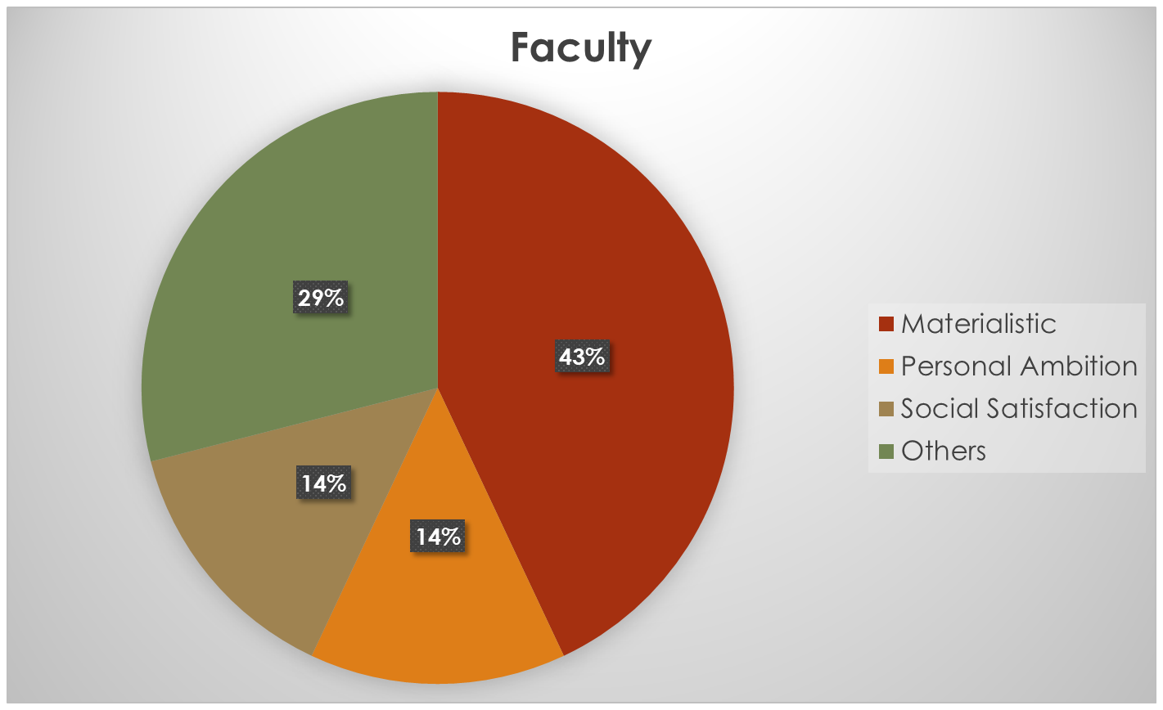
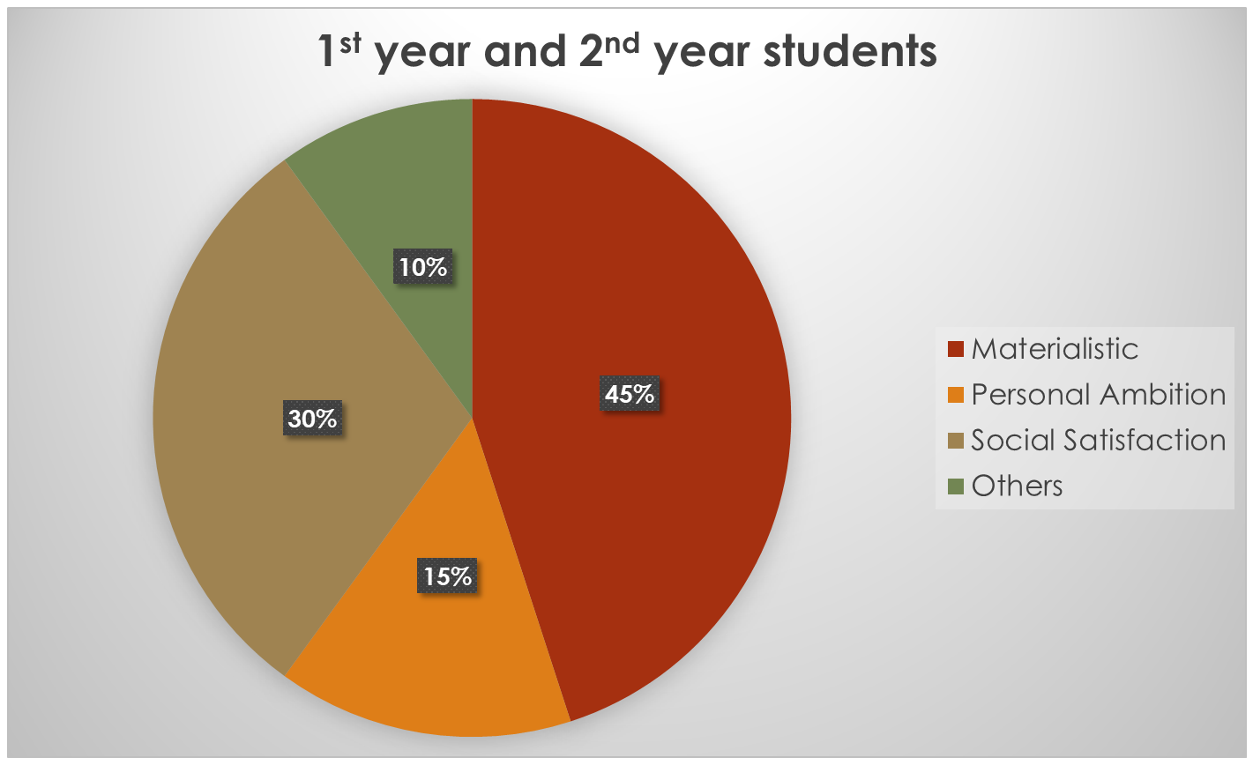
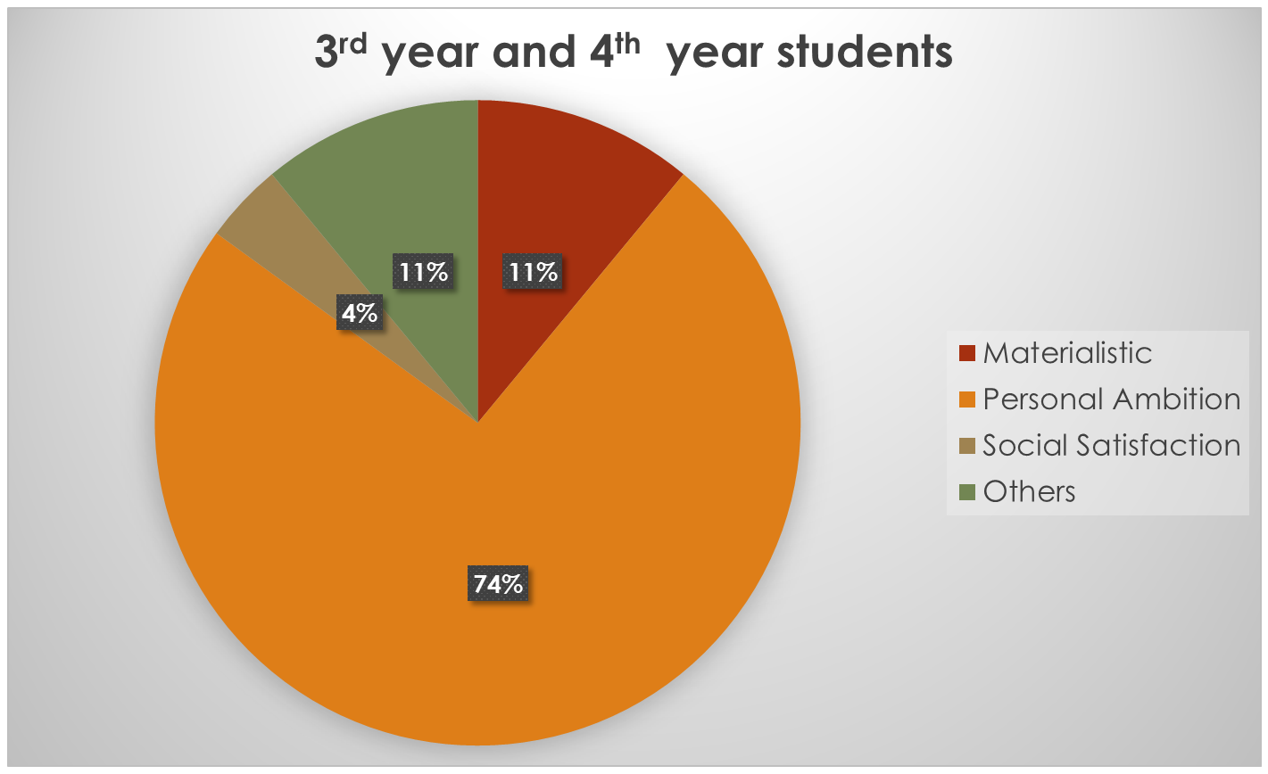
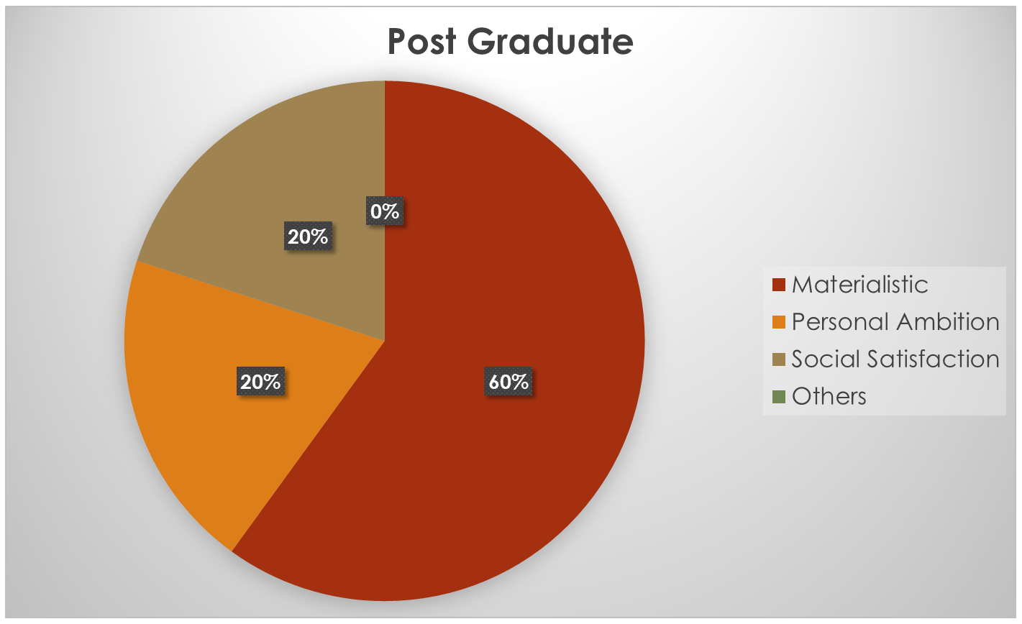
Changes with time
Relaxation and Happiness

Slide 7
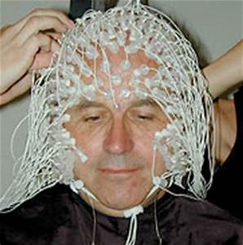
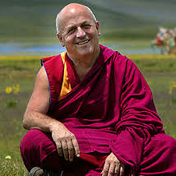
Worlds Happiest Person
Happiness is the state of inner fulfillment
Anyone can be happy, by simply training their brain.
Train the mind by thinking happy thoughts for 15 minutes every day
- Matthieu Ricard
Relaxation and Happiness

Slide 8
Happiness and Desires
Video
Relaxation and Happiness

Slide 9
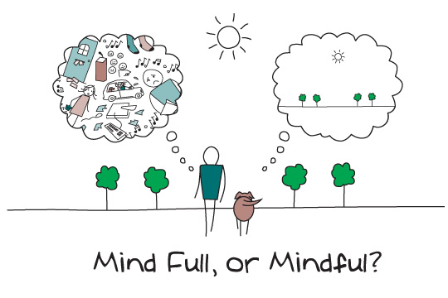
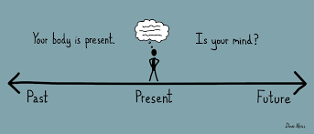
Focus and Concentration
Activity of the mind
Removing clutter
Improve focus, increase concentration
When we read a book in a tranquil state, will we not understand its message better?
Relaxation and Happiness

Slide 10
Coping Strategies
Regular exercise
Yoga
Balanced diet (helps keep your body healthy)
Meditation
Relaxation massage (use your benefit wisely)
Adequate sleep
Regular vacation
Relaxation and Happiness

Slide 11
Heartfulness
Master your life by listening to the heart.
Fine-tune the heart with the mind through meditation on the heart.
A practical and simple technique that can used in parallel with any other spiritual approach
Learn and incorporate at your own pace
Experience your Inner Treasure
Relaxation and Happiness

Slide 12
Relaxation and Guided Meditation
Heartfulness.org
Relaxation and Happiness

